Slide 1
Startup Pitch Deck Template
PowerPoint PowerTools - Get the complete 40+ slide template
Apr. 2025

Slide 2
Contents of the Pitch Deck Template
The following 5 slides serve as a sample of the full pitch deck template, which features multiples slides for each of the following 10 categories
# | Slide type | Objectives
1 | Title | Establishes credibility and sets the tone for the pitch; clearly states who you are, what you do, and how to reach you
2 | Problem | Creates urgency by describing a real, pressing problem that demands a solution
3 | Market size | Quantifies the opportunity by showcasing the size of the problem and the financial potential
4 | Solution | Demonstrates how your product or service addresses the problem (i.e., its value proposition) and provides a unique advantage
5 | Business model | Explains exactly how you make money, who pays you, and your model to scale revenue (e.g., B2B subscription model)
6 | Competition | Maps out competitors in the same market and highlights how you will beat them
7 | Team | Highlights key team members, their expertise, and why they are the best fit to execute
8 | Traction | Provides evidence of real-world adoption, growth, or key milestones that validate the business
9 | Financial projections | Maps out revenue forecasts, key metrics, and a path to profitability
10 | The ask | Clearly states how much funding is needed, how it will be used, and with what investors will get in return

Slide 3
Problem | Trend with chart
[Chart description (e.g., Loneliness epidemic in America)]
Where we are today
[Unit (e.g., percentage of population, M USD spent)]
[Description of a part of the current situation (e.g., what customers are doing now)]
[Description of a part of the current situation (e.g., price)]
[Description of a part of the current situation (e.g., poor support)]

Slide 4
Market size | TAM, SAM, SOM
[$XXM]
[$XXM]
[$XXM]
Serviceable Obtainable Market (SOM)
[Short description of how you calculated the portion of the SAM you plan to capture]
Serviceable Available Market (SAM)
[Short description of how you calculated segment of the TAM you plan on targeting]
Total Available Market (TAM)
[Short description of how you derived the total market demand for your product or service]

Slide 5
Solution | Computer product
[Description of a component of the solution and how it solves a specific part of the problem]
[Description of a component of the solution and how it solves a specific part of the problem]
[Description of a component of the solution and how it solves a specific part of the problem]
[Replace by your product image or insert your mockup behind the transparent computer]

Slide 6
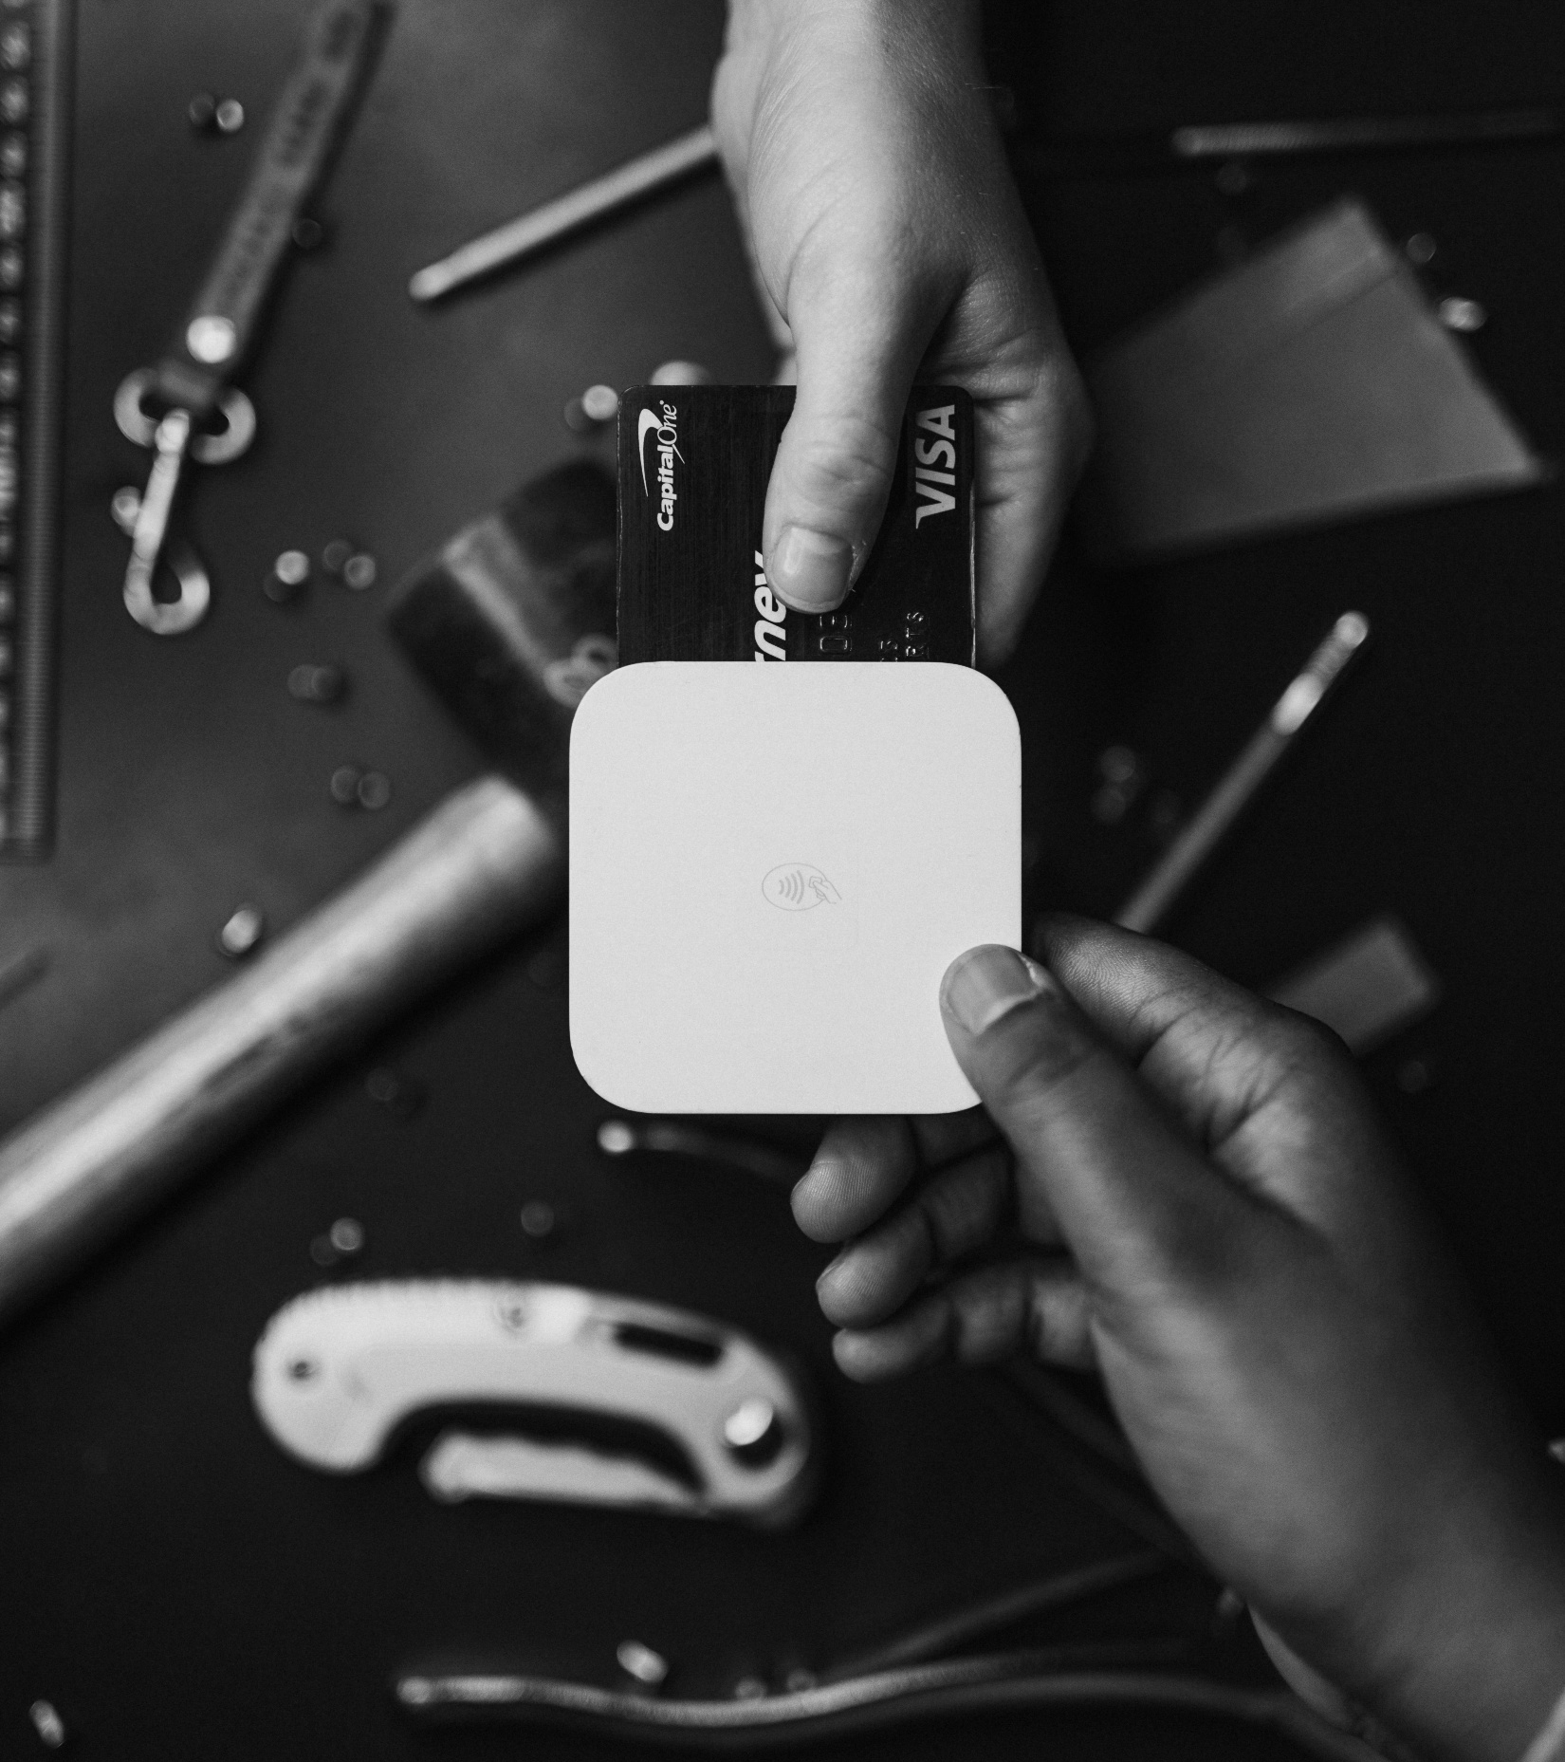
Business model | Metrics
[Short sentence explaining your business model (e.g., “We make 10% on each in-game transaction”)]
[xx%]
[Description of a unit economics metric of your business (e.g., churn, LTV, CAC)]
[$xx]
[Description of a unit economics metric of your business (e.g., churn, LTV, CAC)]

Slide 7
Financial projections | Income statement
Projections
Income statement
[Unit (e.g., M USD)]
 | 2025 | 2026 | 2027 | 2028 | 2029
Revenue | [XXX,XXX] | [XXX,XXX] | [XXX,XXX] | [XXX,XXX] | [XXX,XXX]
Costs of goods sold | [XXX,XXX] | [XXX,XXX] | [XXX,XXX] | [XXX,XXX] | [XXX,XXX]
Gross profit | [XXX,XXX] | [XXX,XXX] | [XXX,XXX] | [XXX,XXX] | [XXX,XXX]
Expenses
Labor | [XXX,XXX] | [XXX,XXX] | [XXX,XXX] | [XXX,XXX] | [XXX,XXX]
Marketing | [XXX,XXX] | [XXX,XXX] | [XXX,XXX] | [XXX,XXX] | [XXX,XXX]
Hardware and IT | [XXX,XXX] | [XXX,XXX] | [XXX,XXX] | [XXX,XXX] | [XXX,XXX]
Office space | [XXX,XXX] | [XXX,XXX] | [XXX,XXX] | [XXX,XXX] | [XXX,XXX]
Total expenses | [XXX,XXX] | [XXX,XXX] | [XXX,XXX] | [XXX,XXX] | [XXX,XXX]
Earnings before taxes | [XXX,XXX] | [XXX,XXX] | [XXX,XXX] | [XXX,XXX] | [XXX,XXX]
Taxes | [XXX,XXX] | [XXX,XXX] | [XXX,XXX] | [XXX,XXX] | [XXX,XXX]
Net profit | [XXX,XXX] | [XXX,XXX] | [XXX,XXX] | [XXX,XXX] | [XXX,XXX]
Revenue
Net profit

